Slide 1

HELLO I AM
我的周评
SIMON PPT

Slide 2
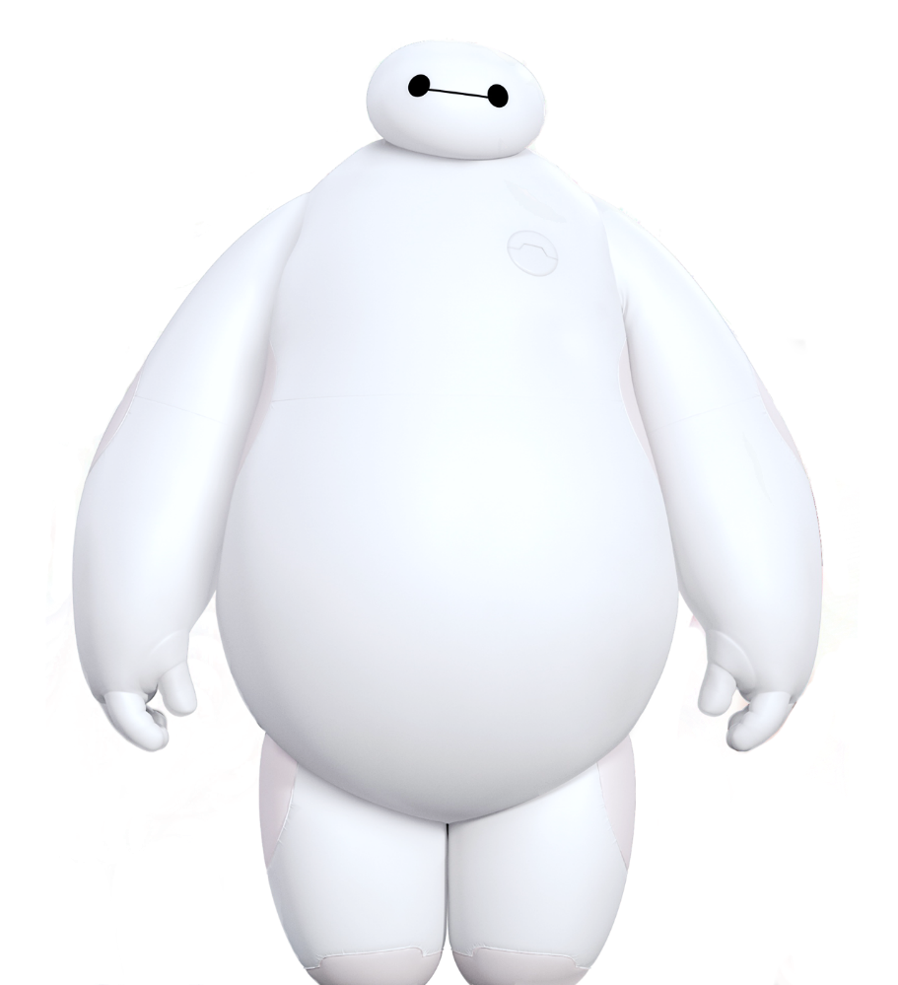
con
tents
Hello. I am Baymax.
3
2
css3
e
css
4
1
动画
html.

Slide 3
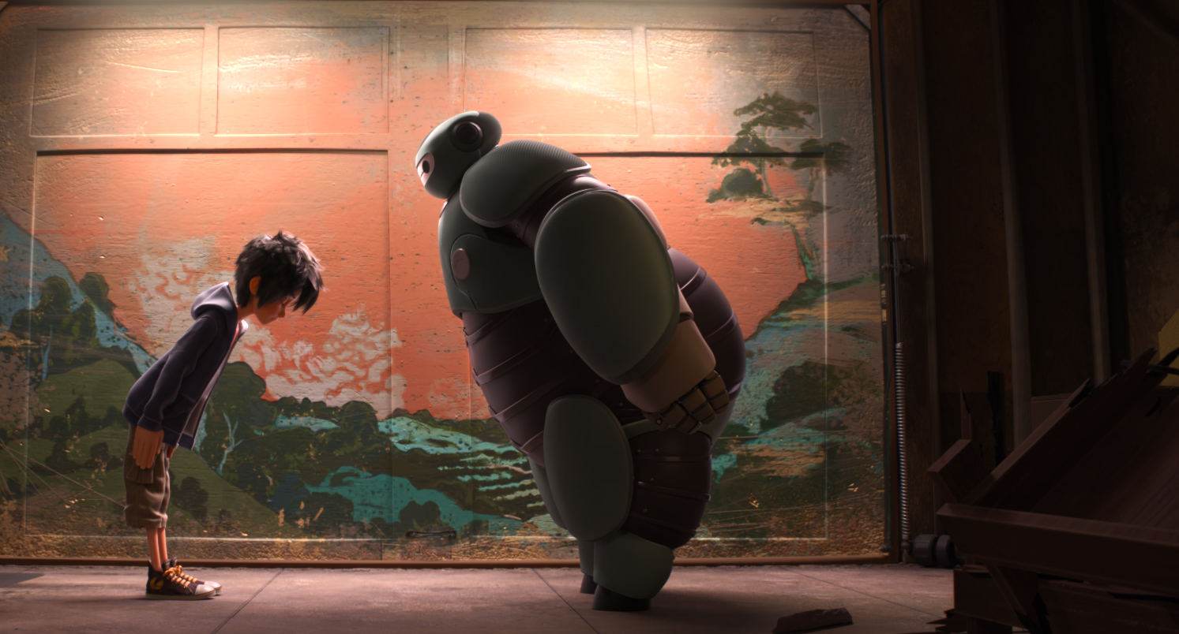
hiro
忠于内心
baymax
忠于自己.
Big Hero 6 is a 2014 film about the story of a young robotics prodigy named Hiro Hamada, who forms a superhero team to combat a masked villain responsible for the death of Hiro's older brother.

Slide 4
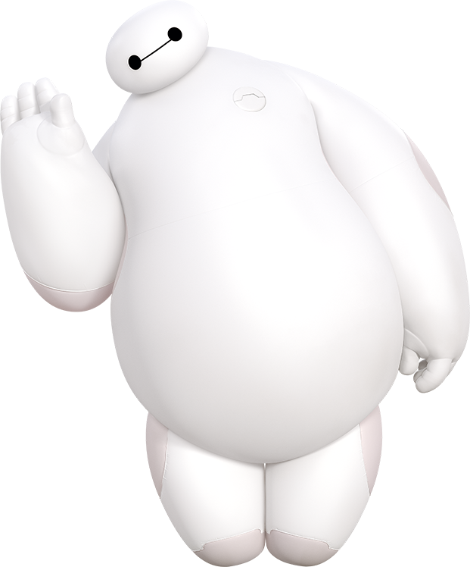
存在的压力
以及学习的方法
再则，自我的感想
1
Part
ONE

Slide 5
like
dislike

Slide 6

SCALE
每天的学习心情
1
2
3
4
5
6
7
8
9
10

Slide 7
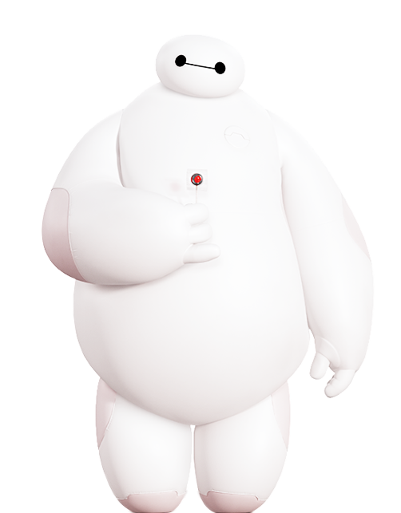
Part
Oh, no.
TWO
2

Slide 8

BAY
MAX
本来也就几种组成方式
也就样式不是很懂
动画你又知道多少
SIMON PPT

Slide 9
9%
上厕所
10%
上班
58%
23%
学习
倒水
PIE CHARTS18小时

Slide 10
I will always be with you.
I will always be with you.
On a scale from 1, to 10,
How Would You rate your Pain?
第一天
第二天
第三天
第四天
第五天
On a scale from 1, to 10,
How Would You rate your Pain?
On a scale from 1, to 10,
How Would You rate your Pain?

Slide 11

Part
THREE
3
结束语.

Slide 12
THANKS
无所畏惧：疯狂摇摆的豆芽菜
Supporters say that the ease of use of presentation software can save a lot of time for people who otherwise would have used other types of visual aid—hand-drawn or mechanically typeset slides, blackboards or whiteboards, or overhead projections. Ease of use also encourages those

